Slide 1
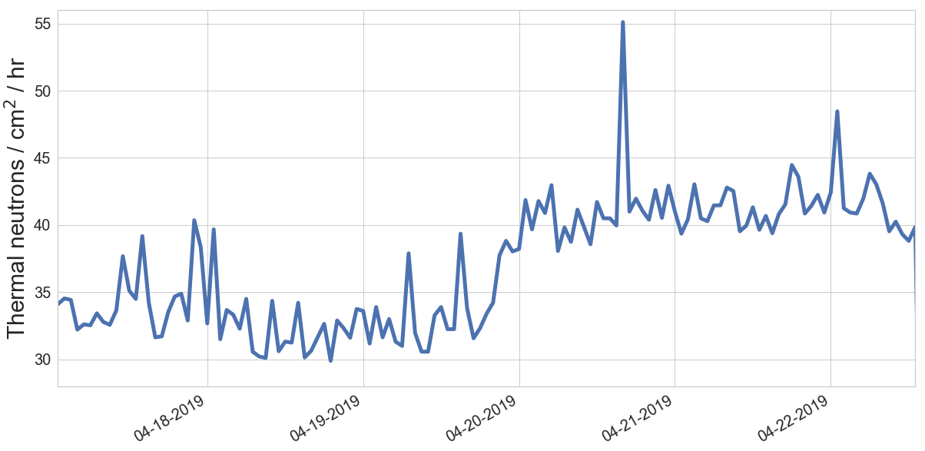
Avg: 41.28 n/cm²/h
24.4% increase
Avg: 33.17 n/cm²/h
2” of water
placed near detector

Slide 2
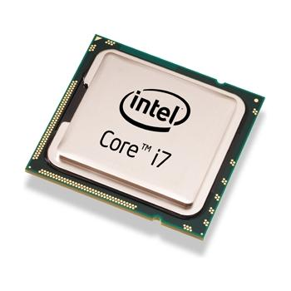
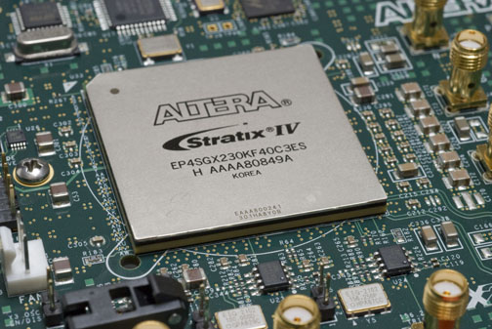
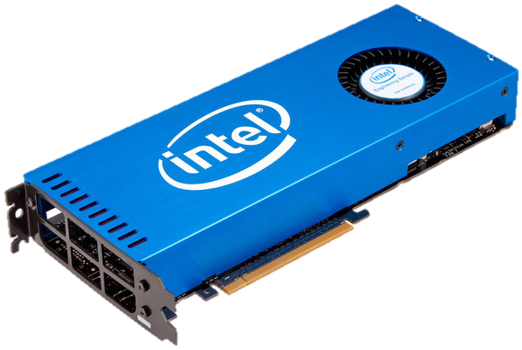


ARM
CPU
co-processor
GPU
FPGA/SoC
Cloud
Consumer
HPC
Data Center
automotive
Good
High
Very High
Reliability Requirements

